Slide 1

Project Presentation 5/17/2021
Notes:
Oscar - This is the call to order/roll call/recognition of any guests (there's none) type out exactly what you will say so we can have a run through. This slide is basically the welcoming slide for the meeting as we wait for people to join.

Slide 2
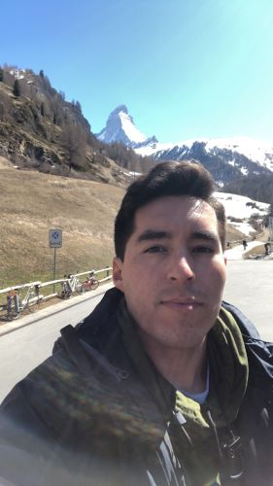
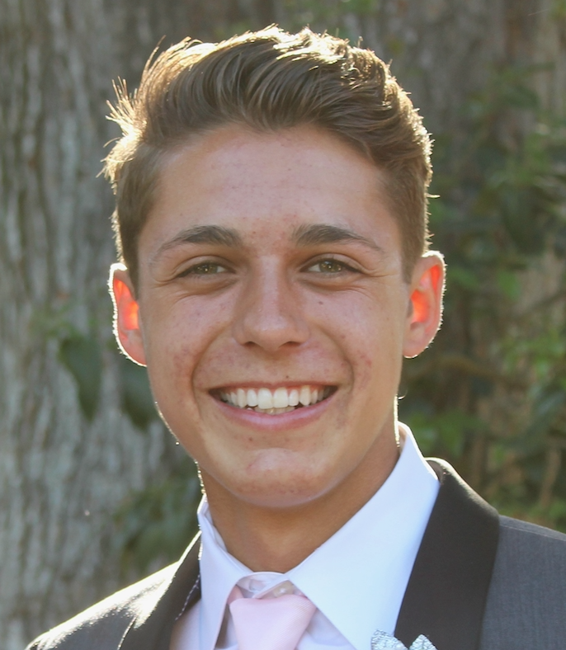


Team
 | Oscar Castellanos - Project Leader
 | James Hanlon - Project Manager
 | Arianna Camino - MultiMedia Programmer
 | Alex Garcia - Documentation & Training
 | Vinny Vue - Programmer/Database Administrator

Slide 3



Project Requirements & Specifications
Notes:
This slide is a quick reminder of what our project’s objective is.
A user should be able to request an image given a location. (lat long coordinates or a street name)
This information should provide the user with a google street image as well its respective metadata.
A user interface should be prompted so that the user can query and see the image

Slide 4
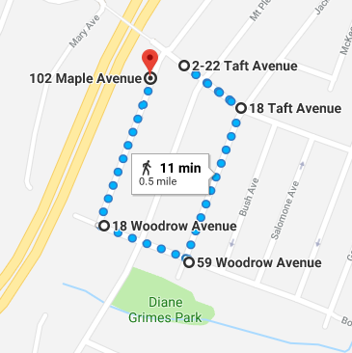


Project Requirements & Specifications
Notes:
Now that we can render any image given any location and coordinate, we need to figure out a method that will allow us to input a location and display multiple images that we can feed into the ML algorithm. After attempting to run the machine learning algorithm I got stuck when retracing the previous groups steps. AWS has updated their platform and a few of the important configurations the previous group did are no longer available, I was also not able to create an instance credential restrictions. I will keep working with Jason so that we can then utilize the machine in our next prototype.
Another future enhancement we will continue to work on is providing a front end user interface with a clean design so that the user does not have to see the script in the inner workings. It would have at the very least a search bar and a results page with the images rendered along with its metadata so that a user like Wes can access this website deployed by the EC2 server.
We still intend to work with the previous groups relational database and machine learning algorithms. Now it's a matter or utilizing our script appropriately to deliver our predefined “Nice to haves”.

Slide 5
Deliverables
A full word document report of our product, which includes executive summary, application development, project management, and group information.
A downloadable zip file containing descriptive files and software needed to run our product.
A link to our GitHub repository which includes:
The program script which will pull the images
A full user manual that is easily followable for any user
All the documents and reports used throughout the project

Slide 6
Requirements Matrix
Req # | Requirement | Description | Task #
1 | User requested location with fixed boundary | User input will determine the distance for search boundaries. User has many options for locations/boundaries. | 65
2 | Collect street view images | Download images to a specific folder, the script will collect the images the user requests | 66
3 | Collect Metadata | Obtain/download metadata from each Street image | 83
4 | Use OSMnx to obtain coordinates/nodes | OSMnx easily can grab and locate coordinates so we can grab multiple images. | 84
5 | Obtain 4 images at each location | For each coordinate, rotate 90 degrees to get image in each cardinal direction. | 86

Slide 7
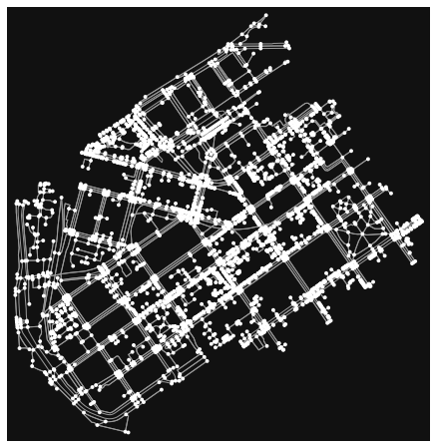
Overview of Product
Able to capture 4 images from each node point from OSMnx; rotates 90 degrees for each image.
Prompts user with 2 inputs; city or a defined region (address/lat and Lng, and a radius in meters).
Able to capture metadata such as below in a JSON file after images are captured.
Notes:
James -
With our last prototype we were able to grab 1 image with an inputted address or latitude and longitude points. With this we could also see the metadata that came with each image. Currently with the new script we can now pull 4 images from one point by rotating the view by 90 degrees. There are two ways the user can retrieve metadata and images. The first way being able to search a city or search a defined location. Within the defined a location you can specify an address or coordinate points and then define a region in meters around the location. OSMnx develops all the nodes within the city or location and can grab the images from Google Street View and display the metadata. As Vinny will show we will need to find a way to scale down the nodes within a city or area. Currently the city of San Marcos which is about 24 square miles captures over 9,000 nodes which is too many.
Now I will pass it on to Vinny to demonstrate our script!

Slide 8
Product Presentation
Notes:
Vinny - Thank you James, now I will do a live demonstration of our prototype. So we designed it so that way it asks for different prompts. We can either do a city or a specific location. I will go ahead and enter in a location. Here we can either do a street address or a pair of coordinates. I will put in this address and It also asks me how many meters I want it to use as a radius. I’ll go ahead and enter in 100. Once a location is entered it’ll generate the map and the number of possible coordinates and this is done using OSMnx. Since this is a small area I’ll request the images. So the script prints the metadata for each coordinate, if the status = ok meaning there's an image available from the Google Street View API, then it’ll also make the request for the image. So here you can see it saved four images for each coordinate. It’ll ask us if we want to search another location or quit. I already ran this ahead of time, searching the size of a city does take a little longer but just to show it returned over 9000 coordinates. I will pass it to Arianna to talk about costs.
550 W Date St San Diego, 92101
San Marcos, California, USA

Slide 9

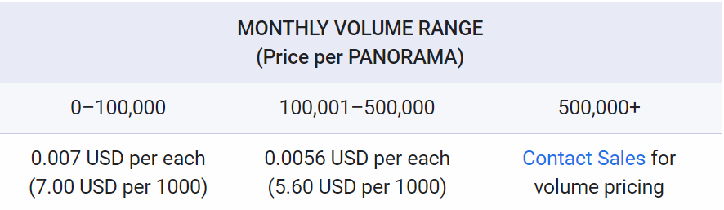

Cost
Pay-As-You-Go pricing
Meta-data is free of charge
Maximum queries per second: 500
Requests exceeding 25,000 requests per day require an API key and a digital signature.
Notes:
Thanks Vinny Once again Google Maps Platform has adopted a new pay-as-you go model in 2018 that allows users to pay for only what they need. This project scope may not require more than 25,000 requests per day, but if a user requests multiple nodes for example a whole state to render nodes and their respective latitude and longitude coordinates that generate 4 images per node, it is highly possible the requests per day may exceed 25,000. Thus far we have generated 403 requests from the console in the creation of the script.

Slide 10
Future Enhancements
Provide a front end user interface with a simple design to display the data.
Connect to the database to save and store images/metadata
Generate a digital signature as another measure of security in case we exceed 25,000 requests per day

Slide 11
Nice to Haves
Req # | Requirement | Description | Task #
1 | Easy user Interface | Create an interface for users that are unfamiliar with code programs can utilize script. Navigation bar to easily display results. | 97
2 | Connect OSMnx to ML program | Contact proveios group to access ML Algorithm. Run instances and figure out how to connect OSMnx data and output ML scores. | 98
3 | Allow random sampling for user | Allow the user to define if they want a number of random samples or a defined amount of pictures in an area. | 99

Slide 12

Questions?
Questions about product?
More testing/displaying?
Future improvements?
Notes:
Oscar - add any images that prompt the client to ask further questions.

